Slide 1
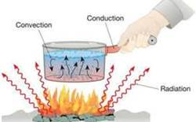
Types of Heat Transfer
Friday 10/25/12
Ignotis

Slide 2
Conduction
Conduction. This method of heat transfer is most familiar to people.
If you have ever burned yourself on a hot pan because you touched it, you have experienced this first-hand.
Conduction is heat transfer through matter.
Metals conduct heat well.
Air is not as good a conductor of heat.
This is a direct contact type of heat transfer. The only air heated by the Earth is the air at the Earth’s surface.
As a means of heat transfer, conduction is the least significant with regard to heating the Earth’s atmosphere.

Slide 3
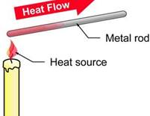
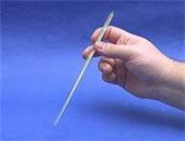
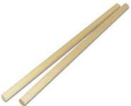
Conduction
YES, this is an example of Conduction, but please don’t place the rods into the flame today.
Cold
water
Hot
water

Slide 4
Radiation
Radiation is the only way heat is transferred that can move through the relative emptiness of space.
All other forms of heat transfer require motion of molecules like air or water to move heat.
The majority of our energy arrives in the form of radiation from our Sun.
Objects that are good absorbers of radiation are good radiators as well.
The atmosphere, which does not absorb certain wavelengths of solar radiation, will absorb certain wavelengths of radiation. The particles that reach Earth from the Sun are within a wavelength that the Earth’s atmosphere will absorb. When the Sun heats the Earth, the Earth gets warmer in that location and re-radiates heat into the atmosphere, making it doubly warm.

Slide 5
Monster Marshmallows
Website

Slide 6
Convection
Convection.
Convection is heat transfer by the movement of mass from one place to another.
It can take place only in liquids and gases.
Heat gained by conduction or radiation from the sun is moved about the planet by convection. The radiation from the sun heats the air of the atmosphere, but the heating of the Earth is not even. This is because the amount of sunlight an area receives depends upon the time of day and the time of year. In general, regions near the equator have hotter air.
This hot air rises, allowing cooler air to move in underneath the warm air.

Slide 7
Popcorn using an air popper
Explanation
Convection
Example: In our popcorn example this relates to #2. The hot air transfers the heat to the cooler kernels, and when enough hot air heats the kernels they pop.
Every day life examples

